Slide 1



Meetup PostgreSQL - FastTransfer
Move data faster

Slide 2
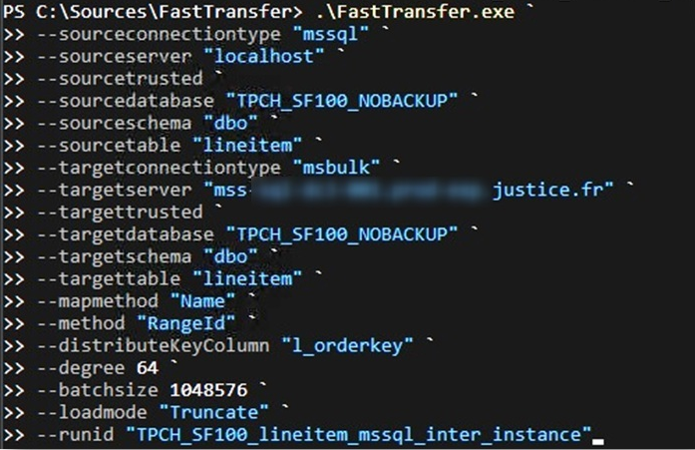
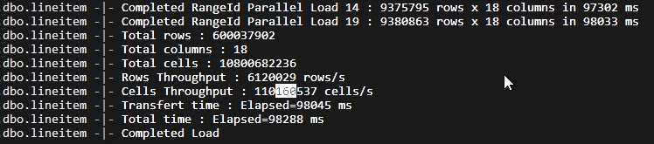
1 command line ➔
600M Rows x 18 columns moved between 2 different MSSQL Instances over the network in 98s 110M cells/sec

Slide 3
With FastTransfer, ENEDIS copy 153 tables from postgreSQL15 to MSSQL 2019 twice a day for one year.
In12min instead of 1h40min
CPU is the bottleneck

Slide 4


Romain Ferraton CEO Architecture & Performance DBA – DB Perf Tuner Lead Developper @Arpe.io Play with databases for 25 years with Oracle, DB2, MS SQL Server, Teradata, SAP HANA, PostgreSQL, MySQL, Snowflake, BigQuery, DuckDB, EXASOL, ClickHouse
linkedin.com/in/romainferraton/

Slide 5


Pierre-Antoine Collet Junior DBA Architecture & Performance Developper @Arpe.io
linkedin.com/in/pierre-antoine-collet-6a3747222/

Slide 6

What is FastTransfer

Slide 7
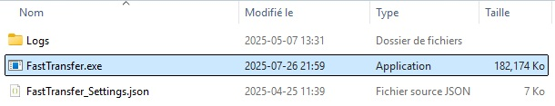
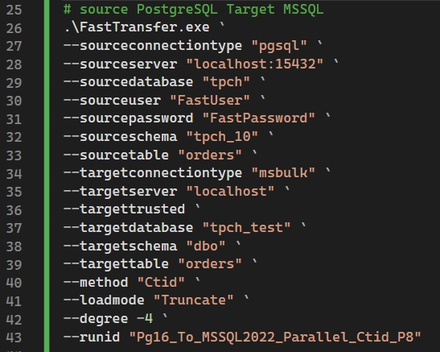
FastTransfer
A command line, no installation, use directly
Available on Windows and Linux
A tool to copy data from a source to a target really fast using parallelism
Data is streamed : no step files
Native Drivers Included
Simple to use and integrate within existing tools : ETL, Scheduler, DBs, Docker, Lambda
Modern Secured Logging to several potential sinks
Source
Target

Slide 8
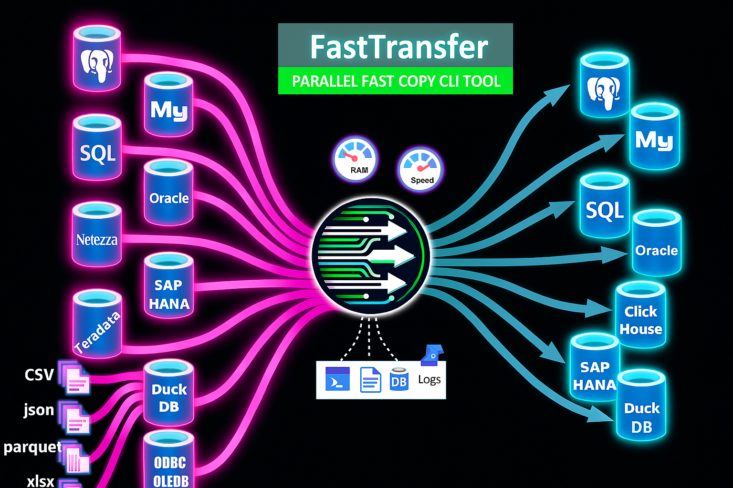

Slide 9

Why using FastTransfer

Slide 10
Do you Move Data ?
Fast ?

Slide 11
Not fast enough ?

Slide 12

Hey ! Why not use a Big VM or a big cloud instance to go faster ?
Hum…Well… Let me tell you a story

Slide 13
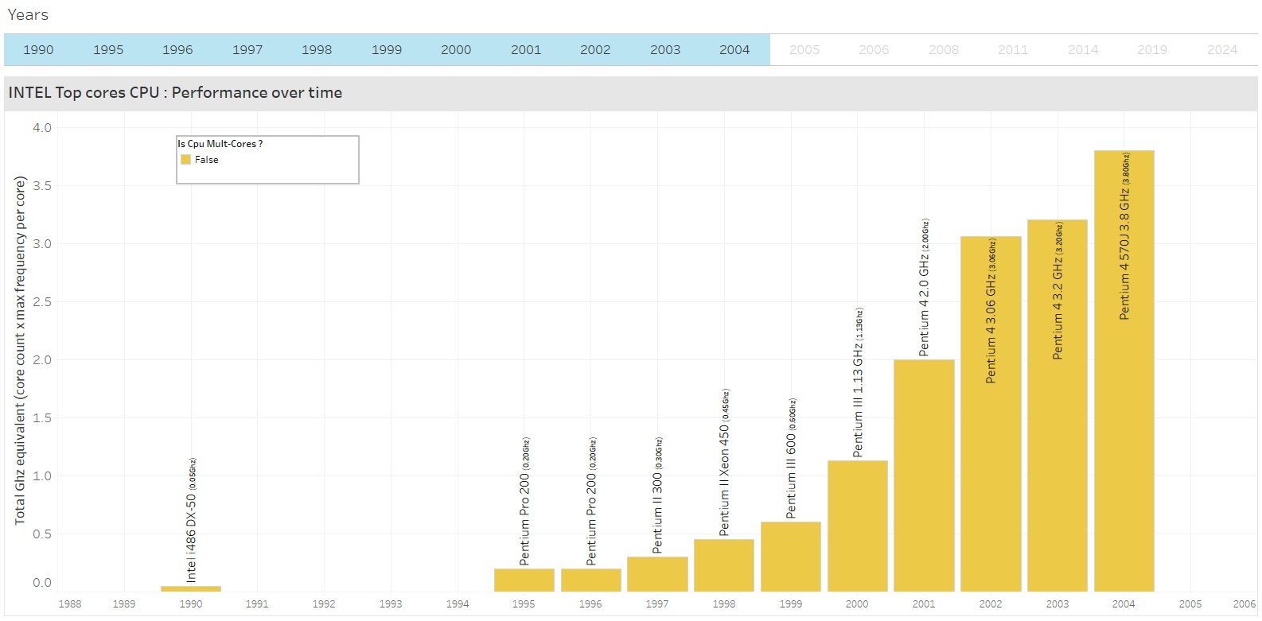
At the dawn of time there was 1 core per CPU
3.8Ghz (x19)
0.2Ghz

Slide 14
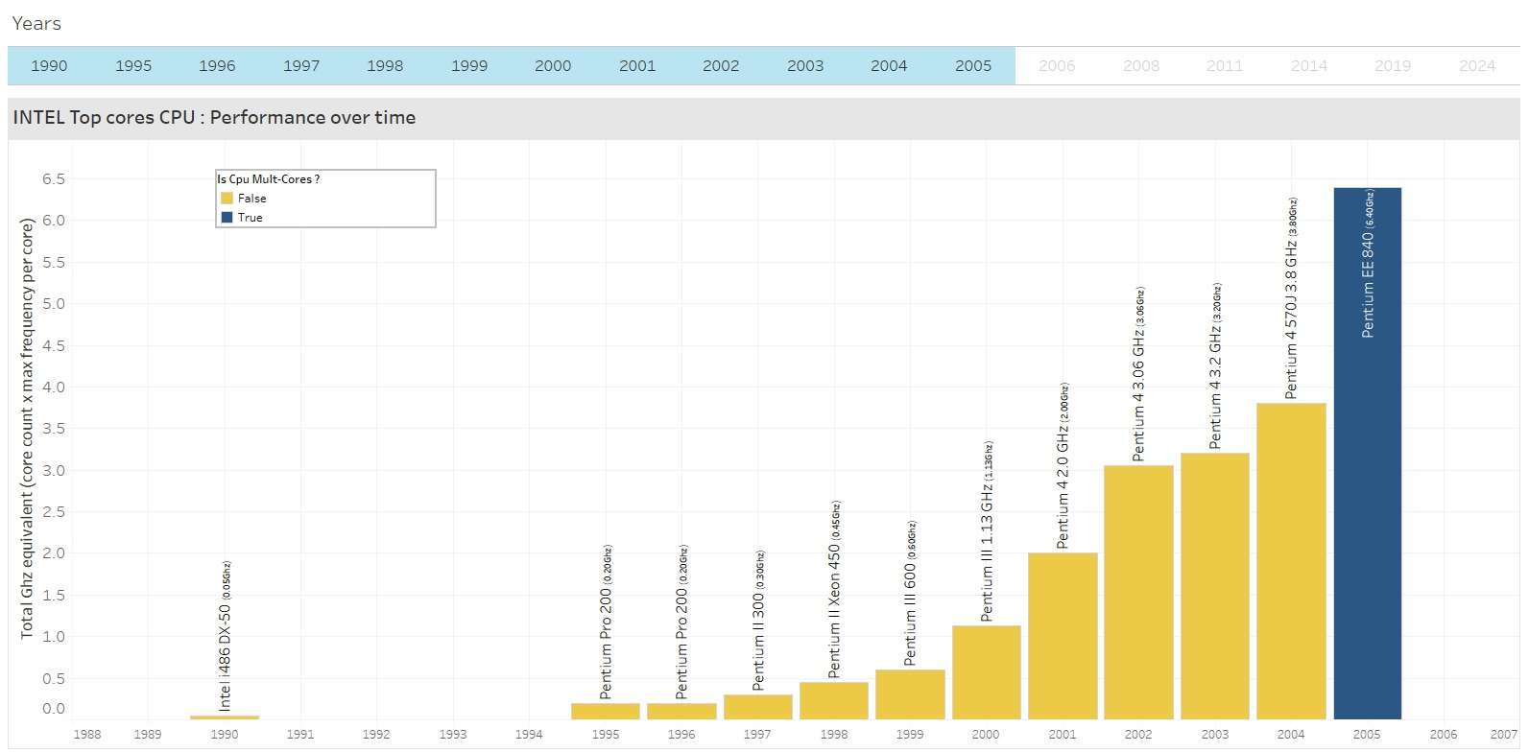
In 2005 - 1st dual core : 6.4Ghz equivalent

Slide 15
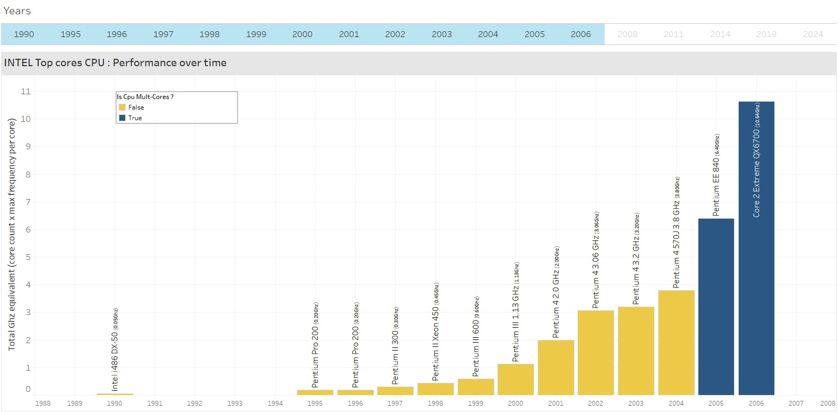
In 2006 : 10Ghz equivalent

Slide 16
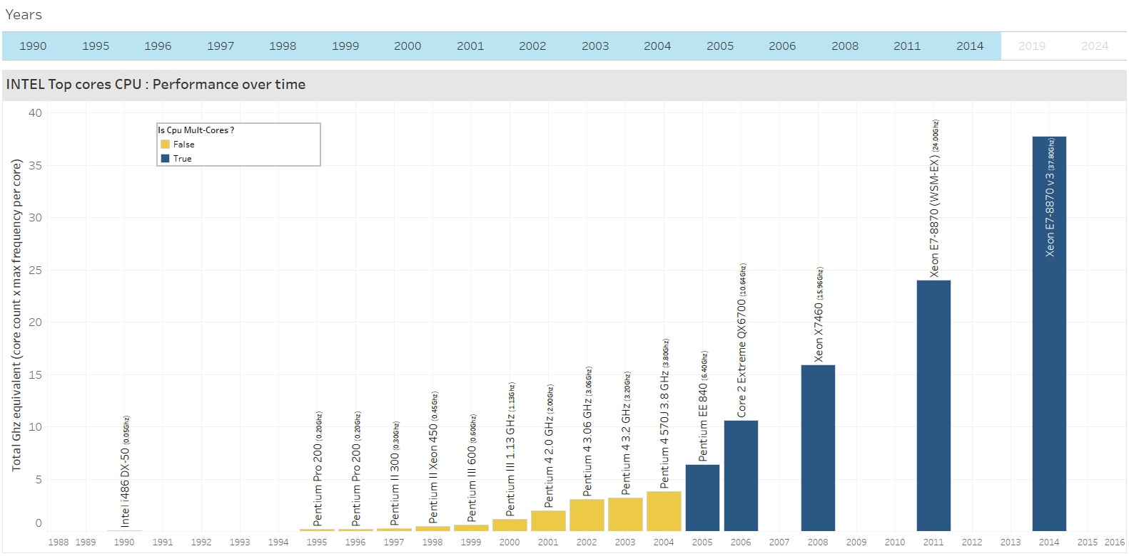
In 2014 : 38Ghz equivalent

Slide 17
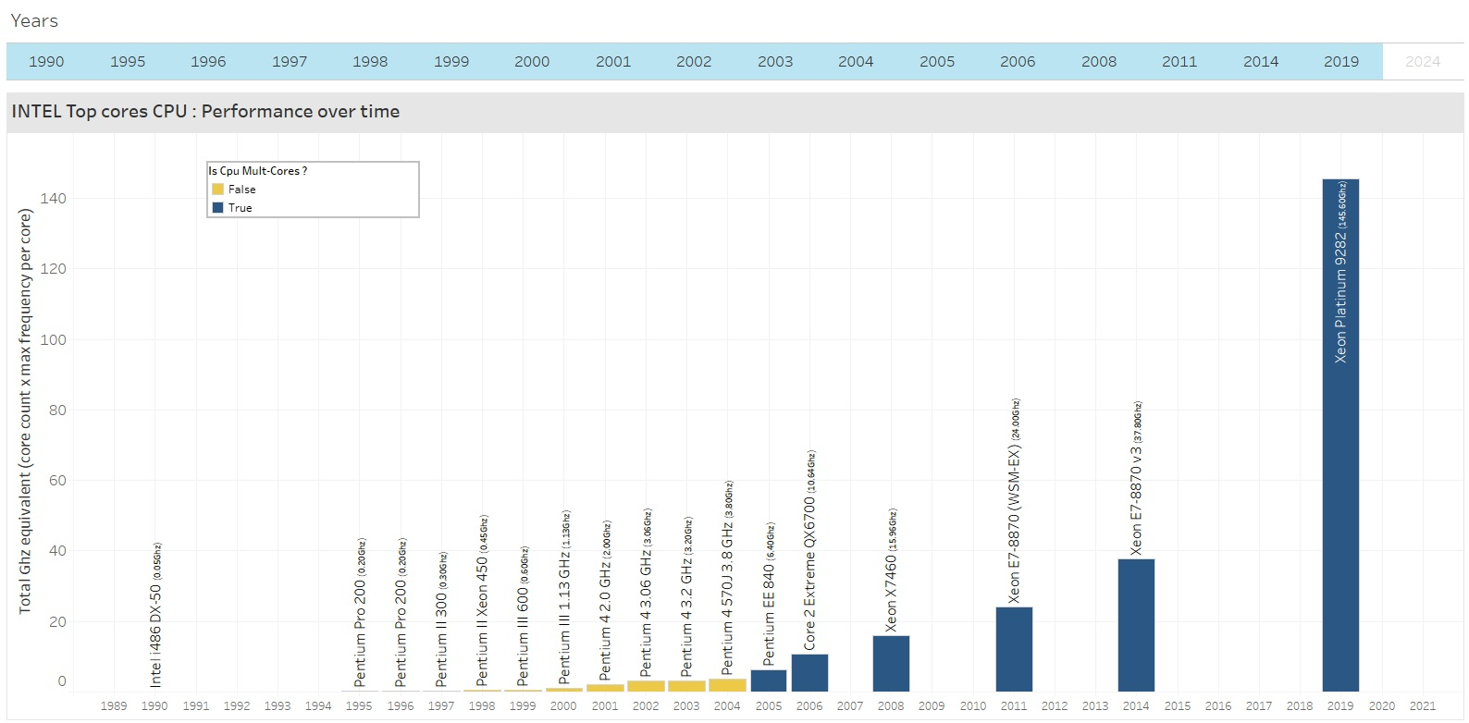
In 2019 : 146Ghz equivalent

Slide 18
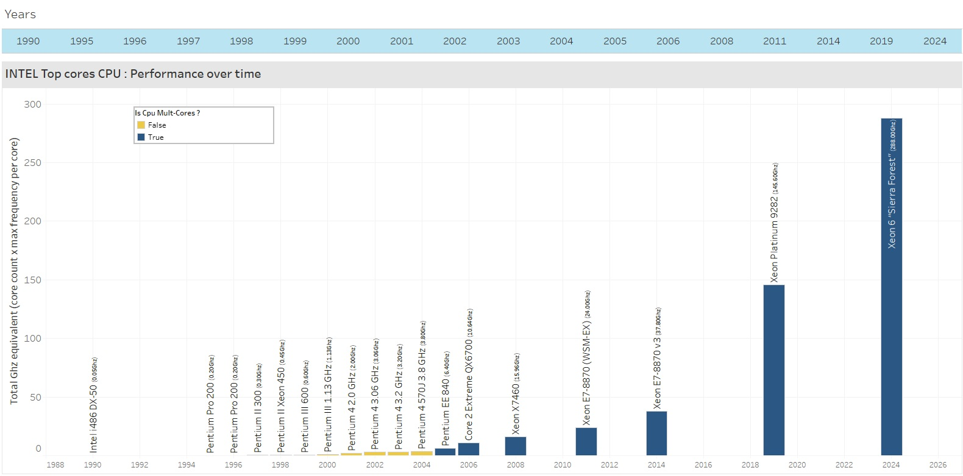
In 2024 : 288Ghz equivalent : 75x better than in 2004
288Ghz (x75)
3.8Ghz

Slide 19
In 2024 : 288Ghz equivalent - 75x better than in 2004
Is your transfer time now 75 times faster than in 2004? (or even 10x faster)

Slide 20
99% of the time, the answer is No

Slide 21
Why ?

Slide 22
99% of the time, transfers, imports or exports are single threaded

Slide 23
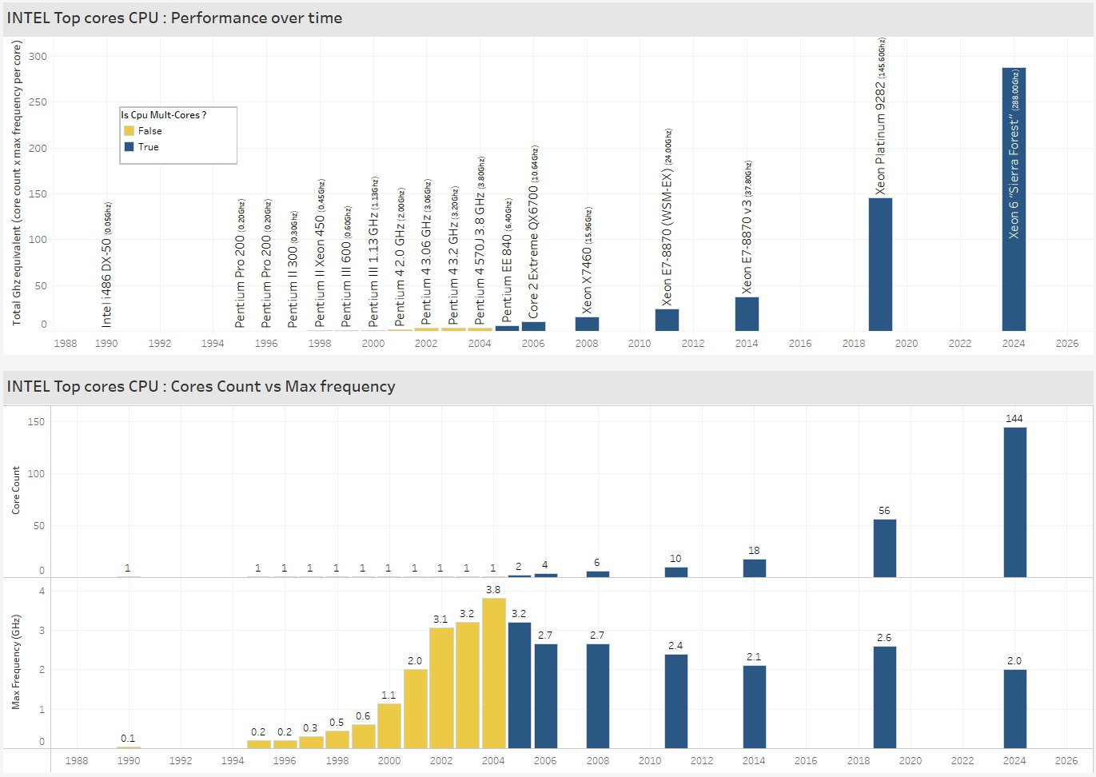
Let’s decompose the Total Ghz Equivalent metric

Slide 25
single threaded data movements are stuck in 2004

Slide 26

And 2004 it was :

Slide 27
We need to evolve

Slide 28
We need parallelism

Slide 29
Yes you can transfer, import or export several tables or queries at the same time

Slide 30
But what to do with BIG tables ?

Slide 31
What is a BIG table ?
A table much bigger than others !
Do you have big tables ?

Slide 32
What happens when you transfer several tables simultaneously?

Slide 33

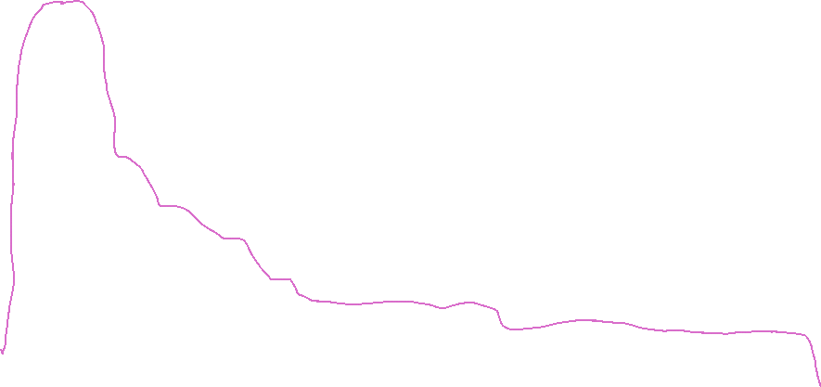

What happens when you transfer several tables simultaneously ?
Let’s add CPU on the machine !
Final gain

Slide 34
We need intra-parallelism to load a single table

Slide 35
How ?

Slide 36


Parallel Copy with FastTransfer
Chunks built @source
CHUNK
01
BULK INSERT
CHUNK
02
BULK INSERT
CHUNK
03
BULK INSERT
One table or one query
One table
CHUNK
N
BULK INSERT
Chunks are built at source
Parallel flow from source to target without files step
One flow defined = one command line
Direct Stream = no step file
Ultra-Fast Copy (Parallel Bulk)
Easy to use (one command)
Easy to install & deploy
Adaptative Parallellism (degree < 0; défaut degree = -4)
Adaptative Mapping by column name (at runtime)
Adaptative Logging (several potential log sinks )

Slide 37
FastTransfer : Build Chunks @ Source ➔ --method parallelmethod
None No parallelism
Ctid Only for PostgreSQL*
RowId Only for Oracle.
NZDataSlice Only Netezza.
Physloc Only MSSQL.
RangeId need a numeric distributed column
Ntile need a distributed column
Random need a numeric distributed column
DataDriven need a distributed column
Notes:
* And pg compatibles (CedardDB, AWS RDS par exemple)

Slide 38
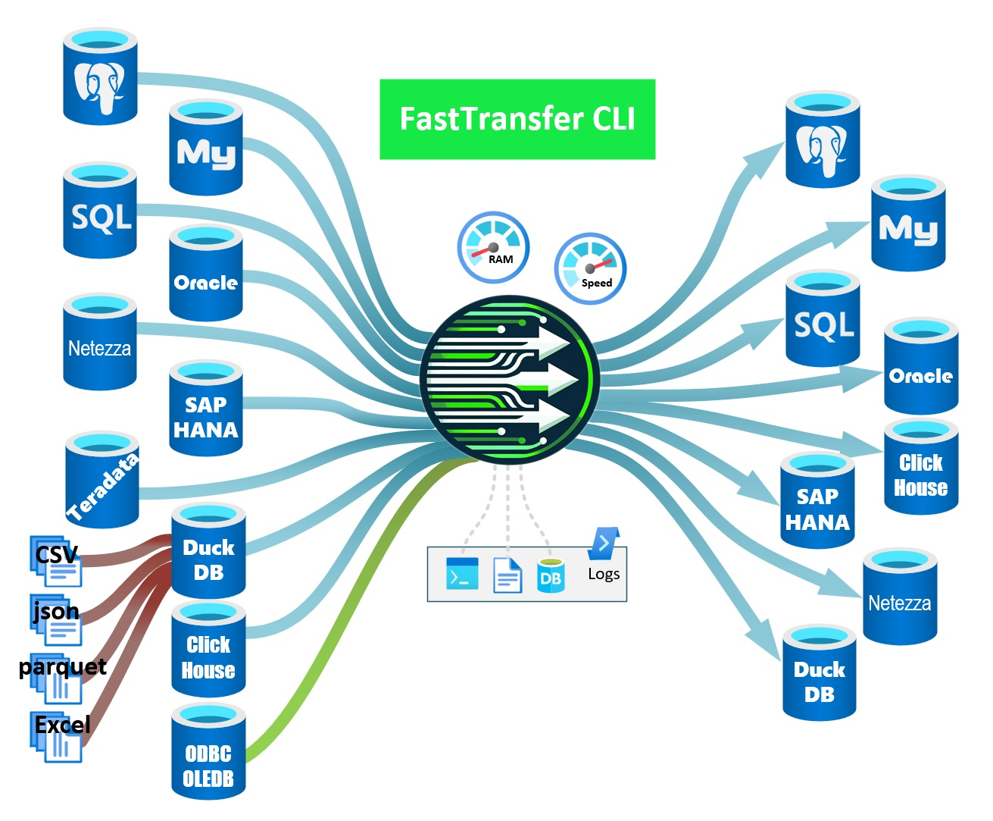
Parallel flows with FastTransfer

Slide 39
Demo time !

Slide 40
Oracle ➔ PostgreSQL
USING CLI

Slide 41
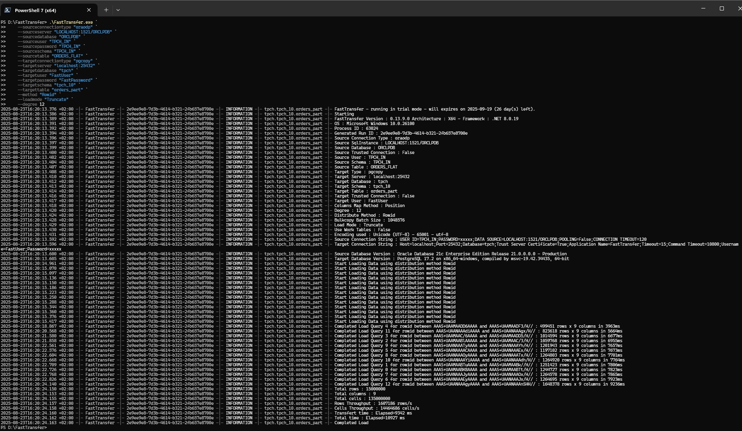
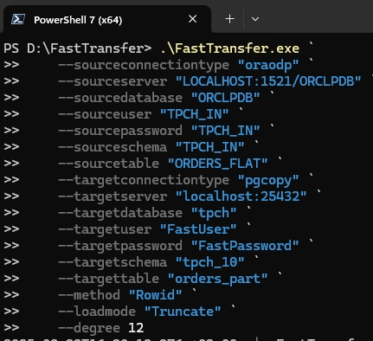
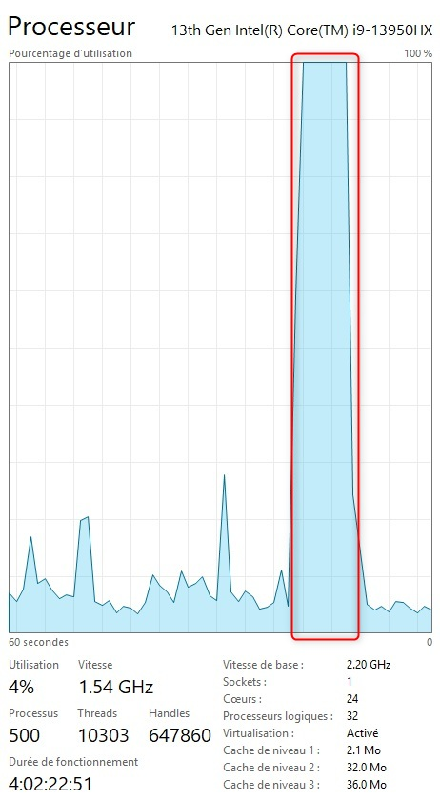
Oracle to PG17

Slide 42
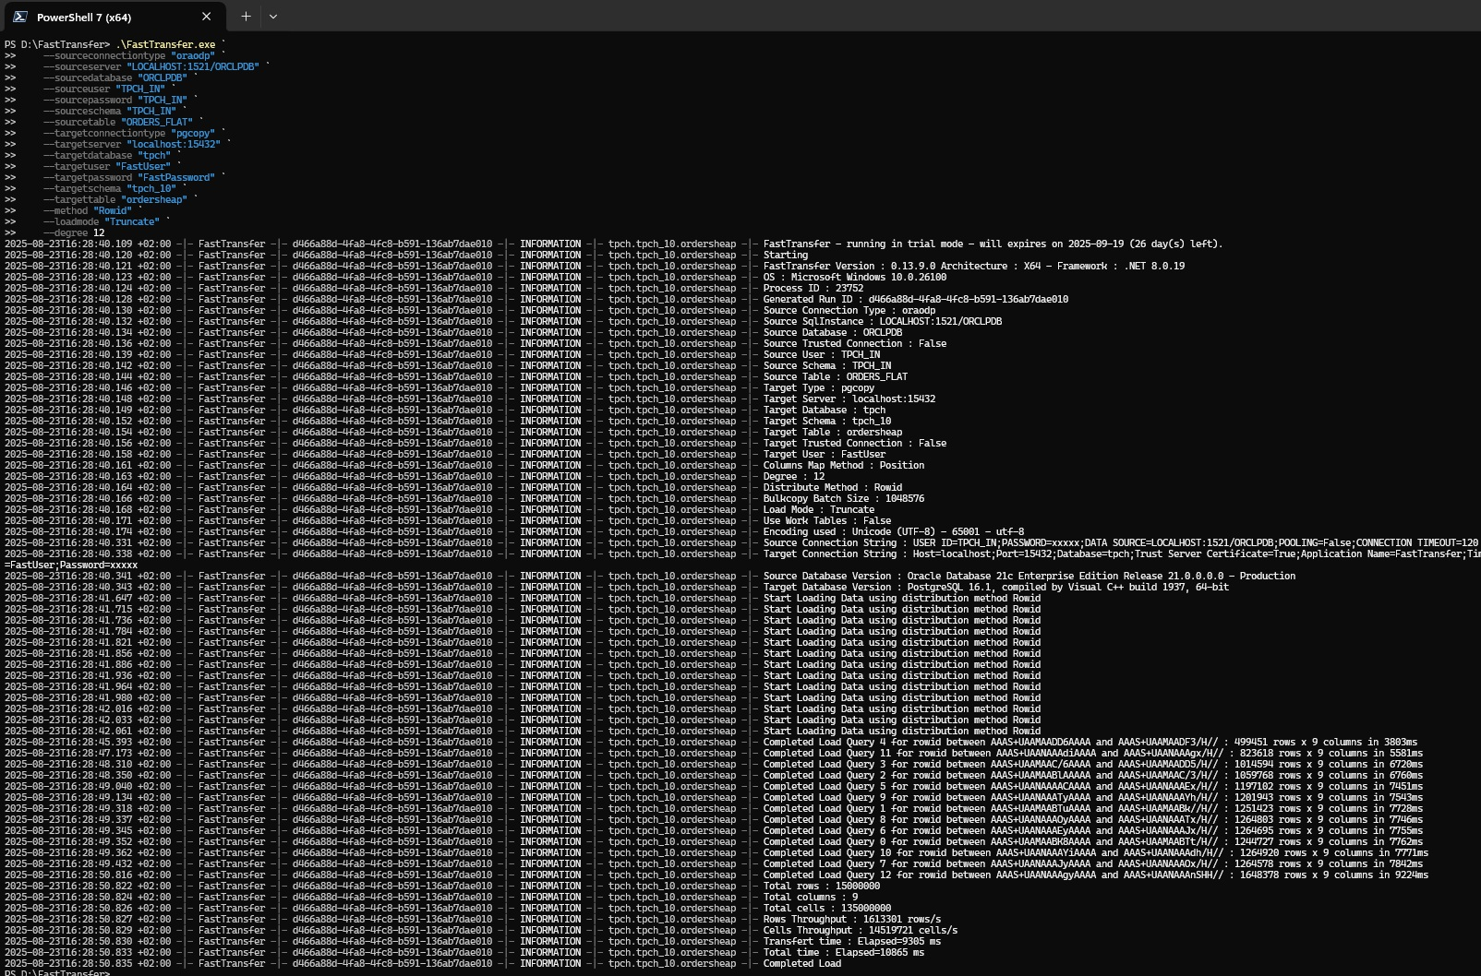
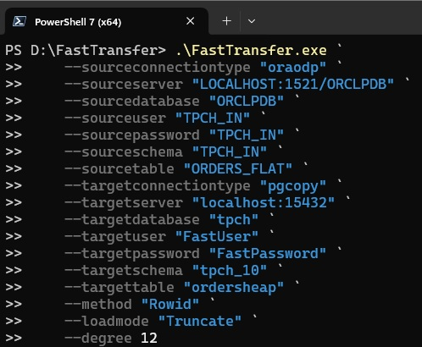
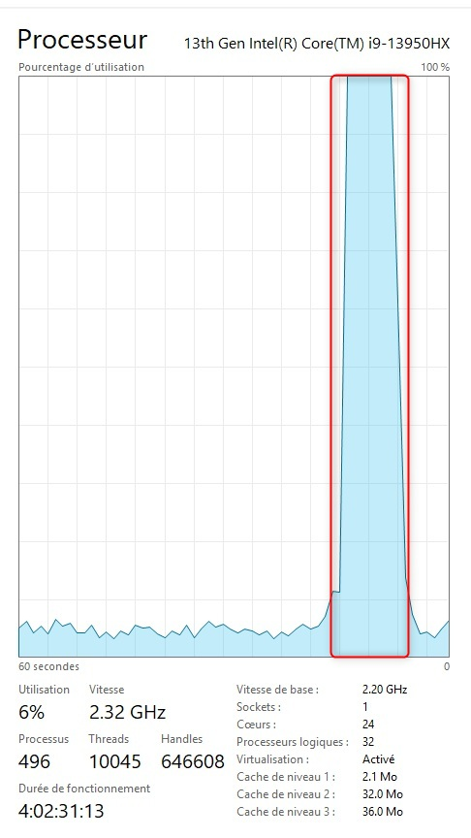
Oracle to PG16

Slide 43
An extension to run it from SQL...
PG_FASTTRANSFER
OPENSOURCE
COMPATIBILITY
SQL
Github repository : aetperf/pg_fasttransfer: Postgresql Extension for FastTransfer
PostgreSQL Extension using 'CREATE EXTENSION pg_fasttransfer'
Linux Support for PostgreSQL 15/16/17/18
Windows Support for PostgreSQL 16/17/18
SQL Function Wrapper : 'xp_RunFastTransfer_secure’
Encrypted Password Support : 'pg_fasttransfer_encrypt'

Slide 44




Demo PG_FASTTRANSFER Architecture
Windows
128 vCPU
128 vCPU
PG16
PG16
pg_fasttransfer
20 Gb/s
dbeaver
Lineitem sf100 600Mrows
Lineitem sf100 600Mrows
FastTransfer binary
SOURCE
TARGET

Slide 45
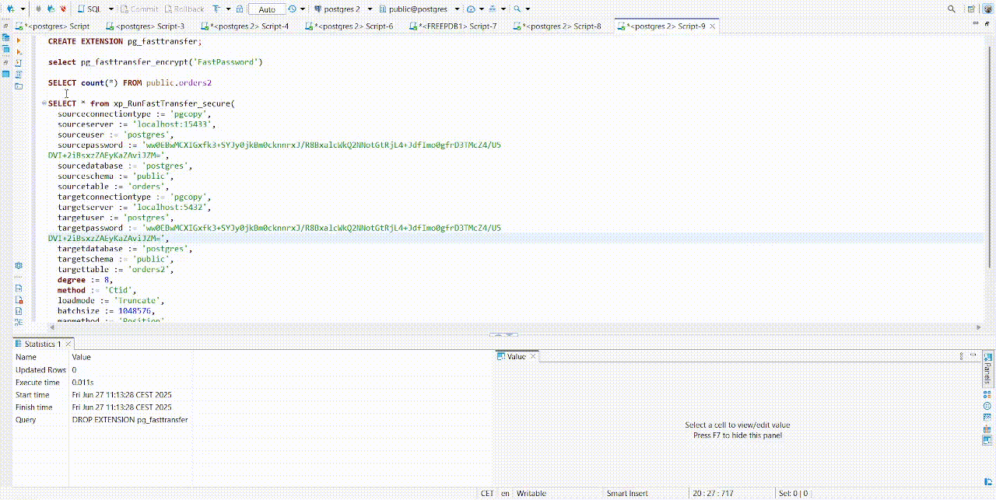
pg_fasttransfer : use FastTransfer through SQL

Slide 46
What was learned ?

Slide 47
Lessons learned to transfer fast with FastTransfer
Read
Choose the good parallel method with your source data/database.
Write
Target DB Parallel Writes capabilities are keys
Database Client play a important rôle
Limit frictions : logged, index, constraints
Infrastructure
Network is key
IOs are also important
CPU : you need them to scale

Slide 48
FASTTRANSFER Tarification
Installez où vous voulez
Pas de limite cpu
Pas de limite serveur
Pas de limite cloud
Pas de limite en nombre d’utilisateurs
Pas de limite de volume
Uniquement vos données ou des données publiques : vous ne pouvez pas intégrer des données d’autres comptes que celui spécifié dans la licence
Support multi-canal 5/7j 9h-18h inclu
ACHETER FASTTRANSFER EN DIRECT sur https://arpe.io

Slide 49




Lessons Learned
From FastTransfer Building Experience
BENCHMARK
Understand how our tools and databases behave
Improve performance through tuning and design
Compare with other solutions or past results
IA HELP A BIT
AI do not invent
AI failed or hallucinate for few or unknown things
Help to accelerate repetitive coding parts
Help for doc and completion
THINGS CHANGE
What’s false today may be true tomorrow..
BOTLENECKS & SCALING
Linear scaling is hard Every solved bottleneck uncovers a new one

Slide 50




Lessons Learned
From FastTransfer Building Experience
DATABASE CLIENT
Is important for transfer performance. NPGSQL is an excellent DB client
STREAMING FAST
Mean no slow down elements on the road :
Disk IOs
Contention/Locks
Logging
Network
Secondary Indexes
MANY CPU
Does not mean faster transfer if you don’t use parallelism. Help a lot if you have the good software and no other break point
NETWORK BW
Network Bandwidth is important for fast transfer if data are on another server and even more if the architecture is with 3 tiers : 10Gbs is the min
FLOW DISTRIB
Evenly distribute data over sub dataflows is not so easy from external applications and strongly depend on database flavor

Slide 51
Meetup PostgreSQL - FastTransfer
Move data faster & easier

